Slide 1


What Makes a Good Game
A Final Project Production

Slide 2


Introduction
Boardgames have become a booming business.
But choosing where to invest is hard with so many options.
This presentation will show which kinds of games succeed and give advice on which ones will make a good bet

Slide 3
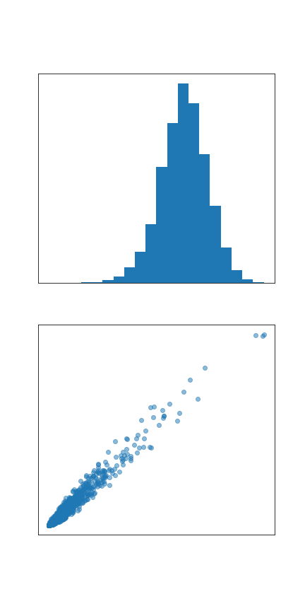
Ownership and Critical Acclaim are the Measures of Success
There are four metrics for success given in the data.
  Owned Users
  Average Rating
  Number of Vote
  Final Ranking
  Ownership and votes are highly correlated and will be used interchangeably
  Ratings occur in a normal distribution
  The method of determining the rank is undisclosed, but strongly correlates with average rating, with some Bayesian averaging and input from number of votes.
  However, ranking and ownership are not strongly correlated, and so they will be used as two complementary methods to measure success.

Slide 4
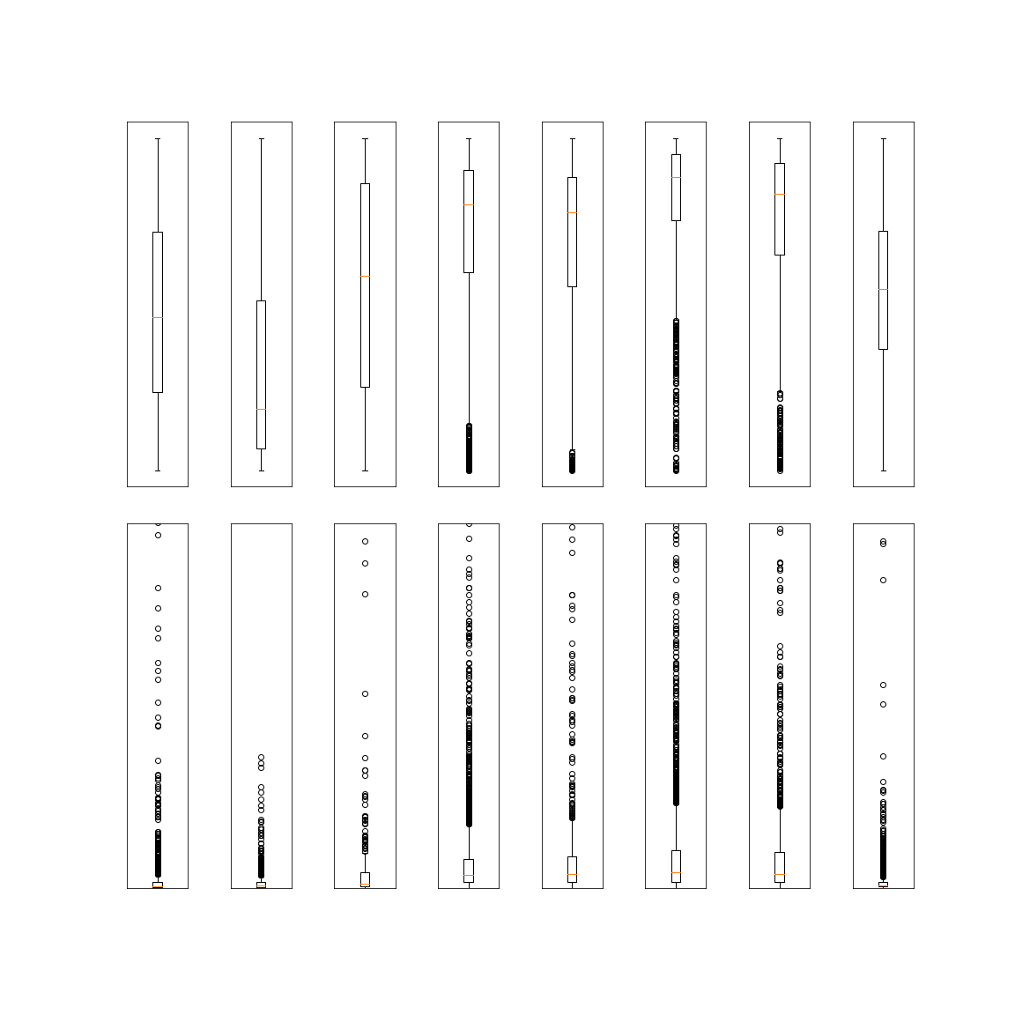
Genre is the biggest predictor of success
Other variables don’t have a large variance in either ownership or rankings between their categories.
  Publication Date has no effect
  Solo capable games do slightly better than games without
  4/5 players games outperform other options
  Playtime has a 45-120 min sweet spot, but it’s not a significant leg up
  Games for children younger than 8 have almost no market.
  These effects are either insignificant or apply to a single category
Genre alone has significant differences between rankings and ownership numbers across all categories

Slide 5
What is a Genre?
As the last slide showed, four genres stand ahead of the others.
Strategy, Thematic, Family, and Party games excel in roughly that order.
It’s worth noting that the median ranking of any other kind of game is lower ranked than the 75th percentile for Strategy
However, what do these genres represent?
  For the four genres, the database gives no definition for two of them.
  Of the two that do, the descriptions are still less than helpful
    Strategy Games are listed as focusing on decision tree analysis and probabilistic estimation, but subsumes part of other genres into itself (ie: abstract games and wargames)
    Thematic Games are listed as ones where the game experience centers around conflict and a central story that drives the experience.

Slide 6
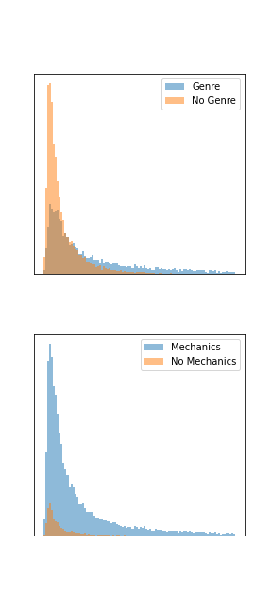
Genres are Unreliable
Besides being mushy, genres are voted on, while mechanics are not.
This manifests in a much larger number of games being without a genre than without mechanics.
  50% of games have no genre
  8% of games have no mechanics
While mechanics exist in proportion to the number of owners, genres also become more likely to exist as a game’s popularity increases
The final concern raised here is that it is possible for a game to fall into multiple genres depending on votes

Slide 7
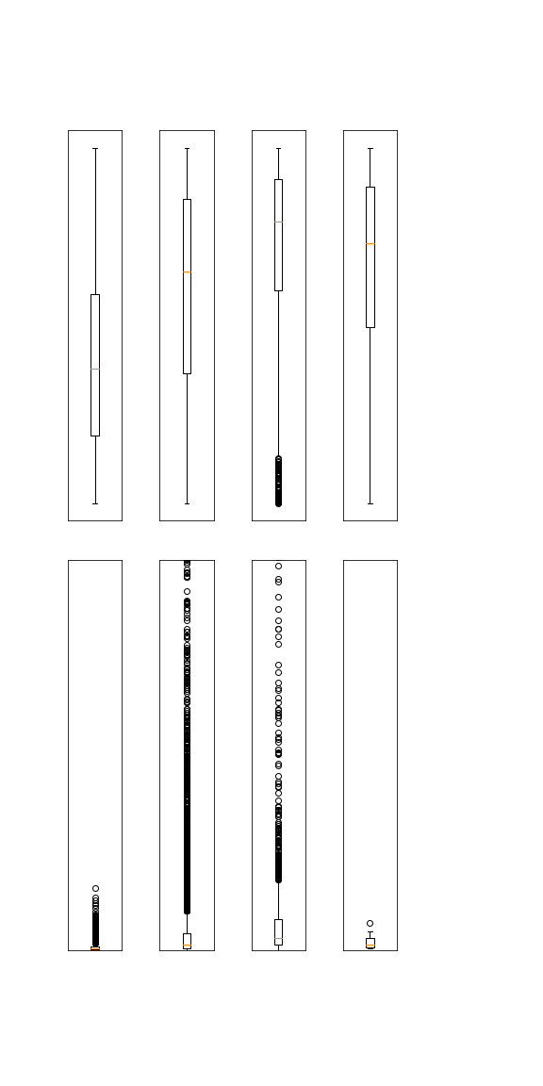
The Best Games Have Two Genres
Games with no genres are completely outclassed by games with any genre
Two genres is the clear champion in rankings, with the bottom of the chart being only outliers, and its confidence zone being denser and better ranked than any other configuration
Considering ownership numbers, one genre does better at outliers, but two genres reaches twice as high for it’s mean and 75th quartile.

Slide 8

Party Games Don’t Overlap
Three of the Big 4 overlap liberally with each other.
Party games are the exception, as they overlap with Family Games, but not the other two.
Strategy and Thematic games lean more towards Wargames outside of the core three.
Family games lean more towards Abstract and Children’s games.
Overlap of Games with Two Genres

Slide 9
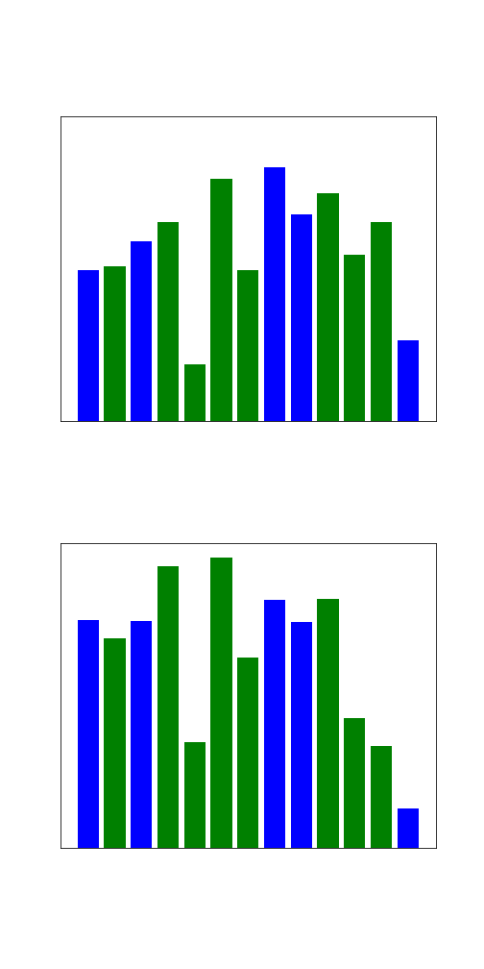
Overlaps Generally Do Not Add Value
No dual genre mix has a higher average ranking than both of the genres that form it.
It is worth noting that Thematic Wargames come the closest to breaking this barrier, followed by Strategic Family games.
The four core genres are roughly equal in ownership numbers.
Three mixes outperform both of their solo counterparts.
  Family/Strategy provides the highest selling category
  Family/Abstract are second highest
  Strategy/Thematic barely manages to outperform its bases

Slide 10
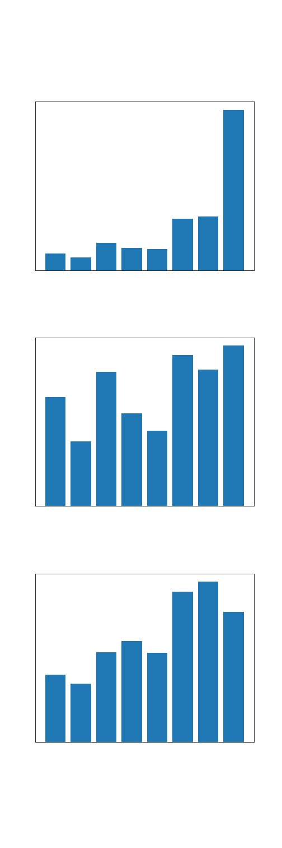
Mechanics are the Foundation
Different Genres have different standards for play time and complexity.
There is a loose correlation between playtime and complexity.
This follows through to the average number of mechanics a game employs.
However, these outcomes suggest that none of these cause the others as while there is loose grouping, there are no obvious strong correlations.
But, the number of mechanics matters less than which mechanics are used, and which ones a genre uses is their core defining feature.

Slide 11
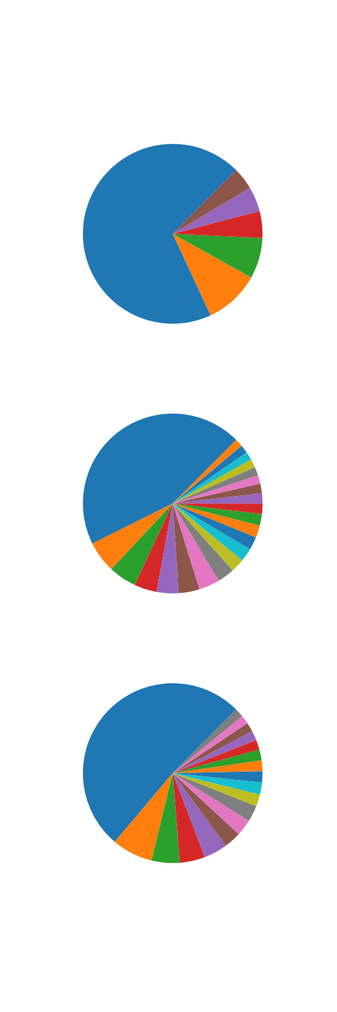
Only a Few Mechanics Matter
There are 182 different listen mechanics.
Including the games with no listed mechanics, there’s still an average of 2.8 mechanics per game.
Despite that, only 17 mechanics manage to be in at least 5% of games.
This decreases to only 5 mechanics in at least 10% of all games.
When looking at the top 200 ranked games, or owned games, these numbers quadruple to around 20.
The following charts show the sums of percentage of games that each mechanic is in.
When looking at Total games, the top mechanics only make up a little over 25%, but they around 50% when looking at the top 200 despite still only representing 11% of all mechanics.

Slide 12
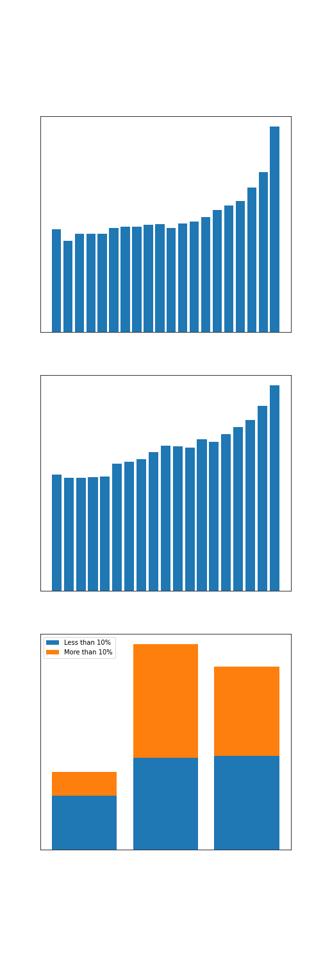
Successful Games Have More Mechanics
The more successful a game is, be it by ownership numbers or by ranking, the more mechanics it will have on average.
When summing together the percentage of games that all mechanics are in, for all games there is a collective 279%.
The top 200 Owned games have a combine percentage of 658%
The top 200 Ranked games have a combined percentage of 737%
As shown in the top graph, the number of mechanics stays steady for most ownership tiers. But once you hit the top 25% the number of mechanics steadily climbs with the difference from the 10th-6th percentile and the top 5 percentiles being a whole mechanic.
While the final ascent of top ranked games is not quite so dramatic, the growth is also more steady, starting at the 75th percentile. It also starts lower, with the lowest 25% having a mere 2.25 mechanics on average.

Slide 13
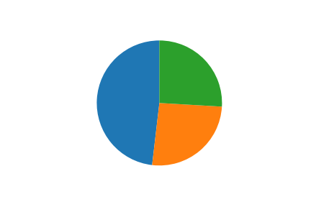
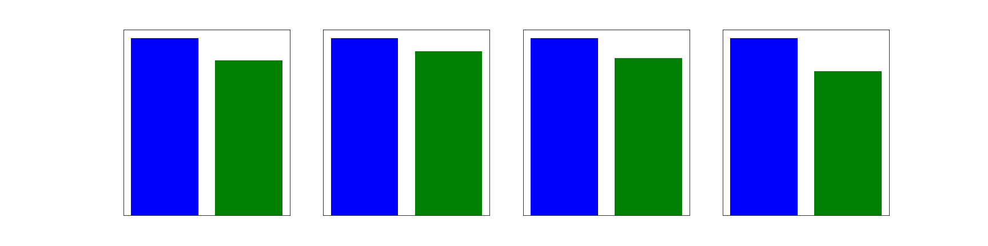
More Complexity and Play Time Favour Critical Acclaim, the Opposite Popular Acclaim
Looking at the top 10% of Mechanics by ranking and ownership, almost half of them are on both lists.
However, despite this, higher ranking metrics show a correspondence with more domains, more mechanics per game, greater complexity and roughly 25 more minutes of play time
Distribution in Core Metrics by Top Ranked or Most Owned Mechanics

Slide 14
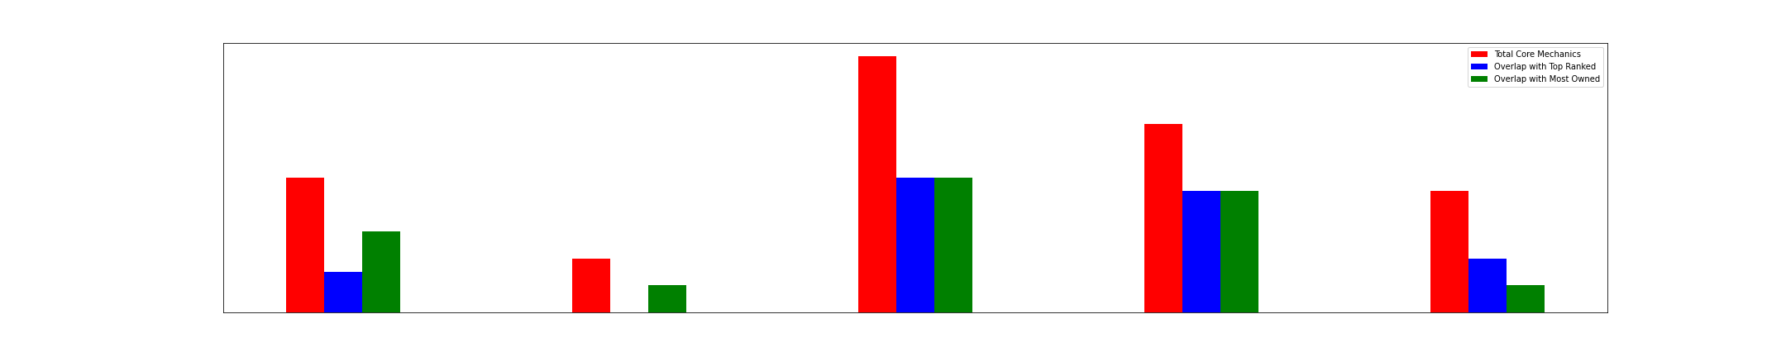
What Are Our Core Genres Made Of?
There are 4 genres worth further study for the purposes of this report.
  Family Games
  Party Games
  Strategy Games
  Thematic Games
Strategy has the most core mechanics at 19
Party games have the least at 4
Strategy also has the most overlap, with 10 of each
Thematic has the highest percentage of overlap, though, with 9 of each for its 14 core mechanics
Party does the worst for overlap, with 2 overlap with owned games, and none with ranked ones
When looking at percentage, Party games are still the worst, with 25% overlap

Slide 15
Overview of Mechanics by Genre
Core mechanics are determined by three values.
  Genre %: How many games in the genre use that mechanic. Mechanics must be used by 5% of games to be included.
  Mechanic %: How many games with this mechanic are in this genre.
  M/G Ratio: How much does this genre use it compared to other genres.
  Either the Mechanic % has to be 10% of all uses, or the Ratio has to be 2 in order for a mechanic to count

Slide 16
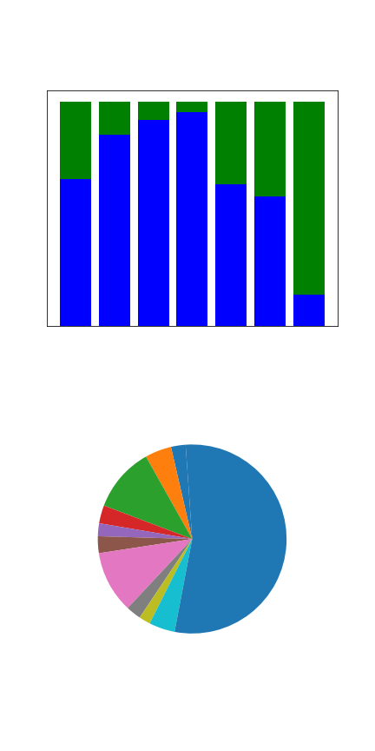
Family Games
Metric | Total | Rank | Owners | Domains | Mechanics | Complexity | Playtime
Value | 2173 | 6086 | 4072 | 1.39 | 2.8 | 1.66 | 40.29
Rank | 3 | 3 | 3 | 2 | 4 | 6 | 5
The counter-example to complexity sells, Family Games are among the least complex but sells well across the board.
Like Thematic Games, they benefit from cross genre support where better games are seen as belonging here.
Core mechanics focus on fast actions that encourage interactivity and some light randomness.
Core mechanics are roughly in line with the rest of the genre’s mechanics, but they are associated with a higher than average number of mechanics.
Mechanic | Rank | Improved
Card Drafting | 3466 | 4224
Take That | 4919 | 4152
Set Collection | 5314 | 4093
Mechanic | Owners | Improved
Card Drafting | 7936 | 4975
Push Your Luck | 5866 | 3380
Take That | 5691 | 3124

Slide 17
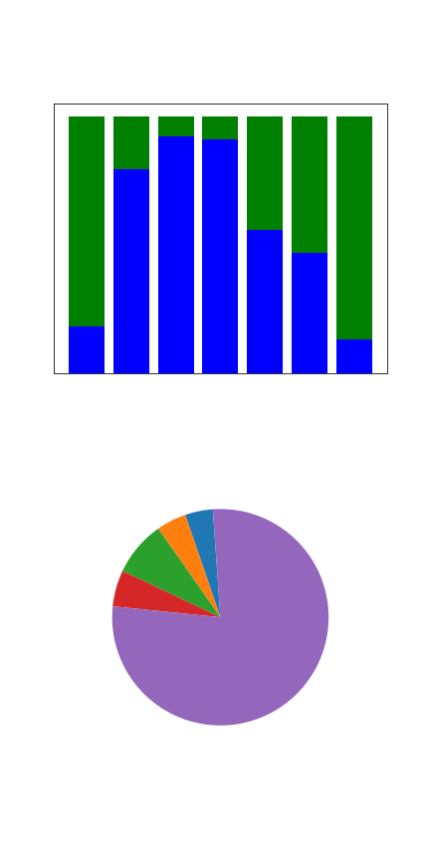
Party Games
Metric | Total | Rank | Owners | Domains | Mechanics | Complexity | Playtime
Value | 605 | 7037 | 4089 | 1.33 | 2.47 | 1.35 | 38.46
Rank | 7 | 4 | 2 | 4 | 6 | 7 | 6
The least complex genre outside of Children’s Games, Party Games focus on being fast and uncomplicated with minimal playtime and mechanics
They also have a broader selection of mechanics, leaving them with only 4 core mechanics
Their core mechanics are focused on the fast paced and social aspect of these games, with Acting, Teams, Voting and Elimination forming the whole
They tend to focus on genre purity while getting paired with more mechanics than average for the genre
Mechanic | Rank | Improved
Player Elimination | 5394 | 5127
Team-Based Game | 4755 | 3844
N/A | N/A | N/A
Mechanic | Owners | Improved
Player Elimination | 7202 | 4460
Team-Based Game | 6057 | 3631
N/A | N/A | N/A

Slide 18
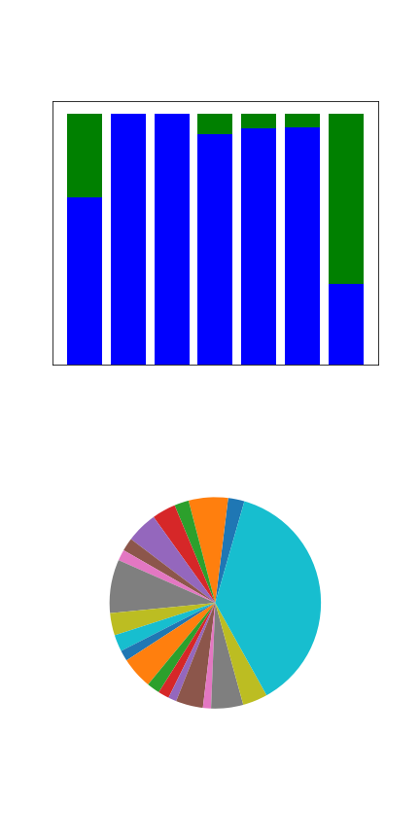
Strategy Games
Metric | Total | Rank | Owners | Domains | Mechanics | Complexity | Playtime
Value | 2205 | 3657 | 4438 | 1.34 | 4.17 | 2.71 | 93.28
Rank | 2 | 1 | 1 | 3 | 2 | 2 | 3
Top of the list in ownership and rankings, Strategy is the most desirable category
They combine numerous and complex mechanics with a relatively short playtime for an attractive package
They also give a substantial boost to all of their core mechanics
Being a genre with mechanics dense games, Strategy has the most core mechanics
Trading and Route Building are notable for adding over a half hour of game time
Solo games are notable for having over 3 more mechanics than an average Strategy game.
Mechanic | Rank | Improved
Set Collection | 2601 | 6806
Take That | 2442 | 6629
Hand Management | 3008 | 5508
Mechanic | Owners | Improved
Take That | 8161 | 5593
Solo/Solitaire | 9563 | 4788
Set Collection | 6794 | 4370

Slide 19
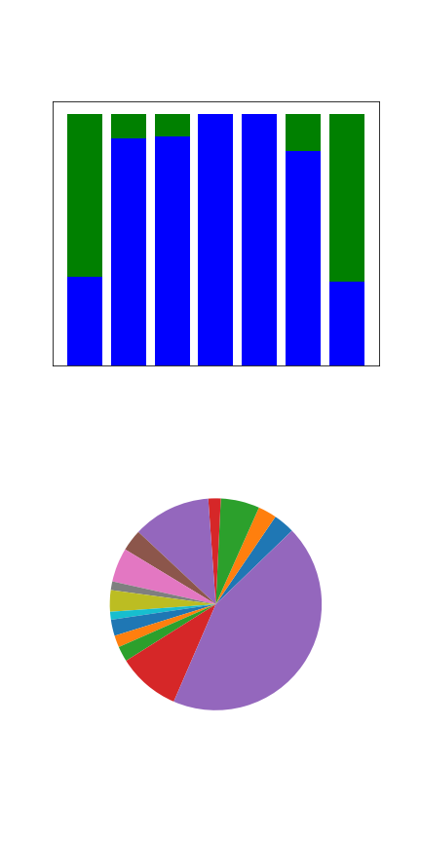
Thematic Games
Metric | Total | Rank | Owners | Domains | Mechanics | Complexity | Playtime
Value | 1174 | 5232 | 4045 | 1.46 | 4.44 | 2.44 | 96.83
Rank | 4 | 2 | 4 | 1 | 1 | 3 | 2
Typically considered the home of traditional American style games as opposed to Strategy’s European style, Thematic games boast a heavy overlap with Wargames and can be seen in some ways as connected to the best of that genre.
Core mechanics get the biggest boost from being in this genre
They also focus on story, controlled chaos, map movement, and competition.
Core mechanics also feature in the more mechanically heavy games in this genre
Mechanic | Rank | Improved
Player Elimination | 3948 | 6572
Storytelling | 3345 | 6168
Scenario/Mission/Campaign | 2752 | 5061
Mechanic | Owners | Improved
Scenario/Mission/Campaign | 9140 | 7328
Storytelling | 7694 | 5350
Solo/Solitaire | 9140 | 4365

Slide 20
Conclusions
Genres provide a roadmap to success, giving four paths.
Lighter games should focus on short playtimes and mechanical simplicity
Heavier games should have high mechanical density, creating complexity. But kept reined in with either a tight play time window, or bound together with a strong narrative element
Finally, core mechanics are consistently higher than average on number of mechanics in a game, showing that they are often a binding agent improving other mechanics they’re paired with.

Slide 21
Appendix
Data used came from Board Game Geek (www.boardgamegeek.com)
Specific datasel used was a data dump from July 5th, archived here (https://ieee-dataport.org/open-access/boardgamegeek-dataset-board-games)

